Slide 1

Geospatial Analysis for Urban Mobility Enhancement
Akash Murali
Prudhvi Vuda
Dhanush Akula
Satwik Reddy Sripathi

Slide 2
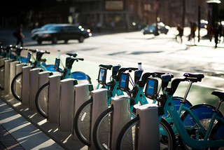
Who we are?
Data Analyst Team at Lyft Bikes & Scooters for the San Jose region, specialized in market growth strategies.
What's our Objective?
Optimizing station placements, improving ride availability, drive profitability for both the company and users.

Slide 3
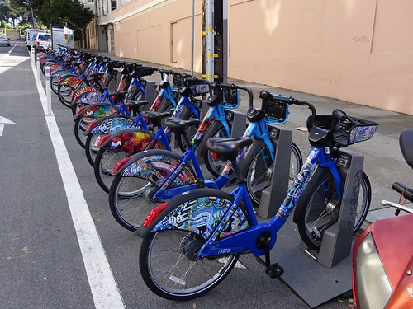
Dataset
Lyft's Bay Wheels bike-sharing data (Publicly available on Lyft's website: Lyft's Bike Share Dataset)
Size of the data ~ 2.5 Million records
Contains 13 features
Key contributive features:
Rideable Type
Geographic Locations of the Stations (Latitude and Longitude Coordinates)
Type of User
Duration of the trip
.

Slide 4

Baseline Analysis with the cleaned data

Slide 5
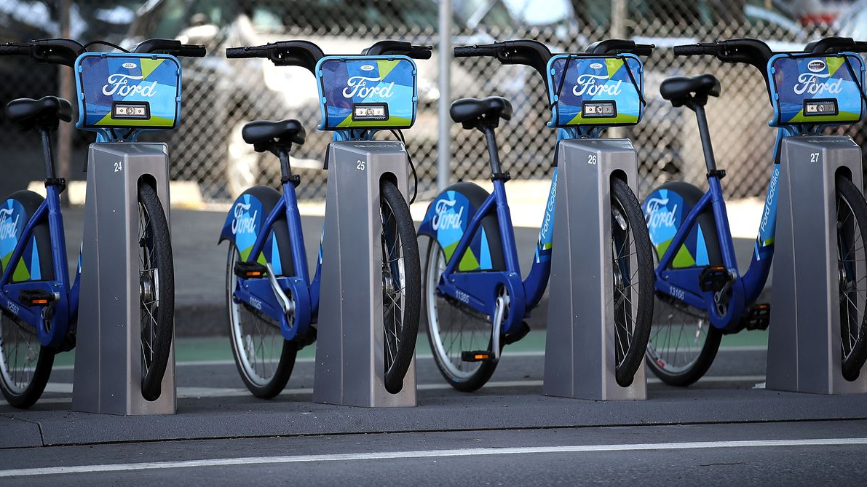
To understand Urban Travel Patterns
When do users use the service the most?

Slide 6
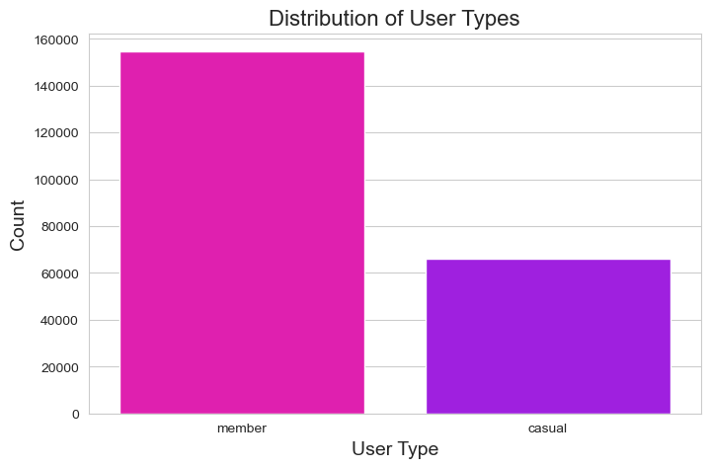
What kind of Users ride the bikes?

Slide 7
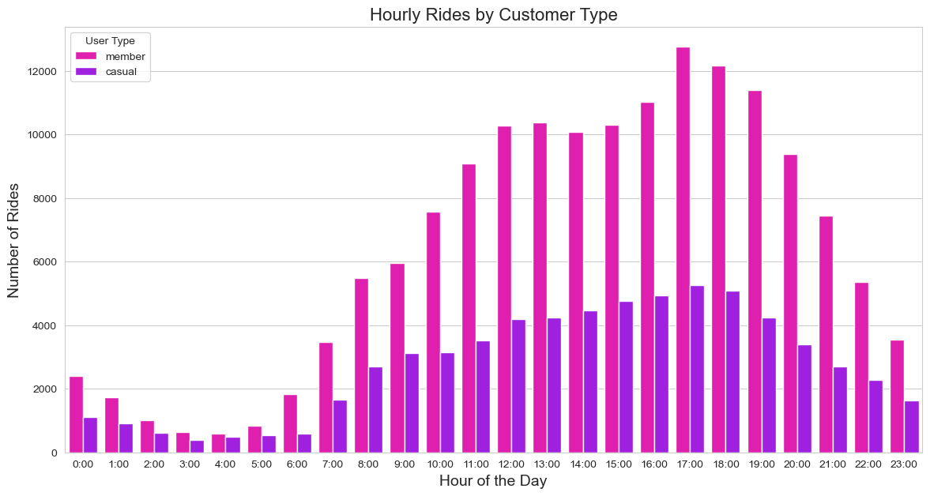
When are the peak hours of bike usage?

Slide 8
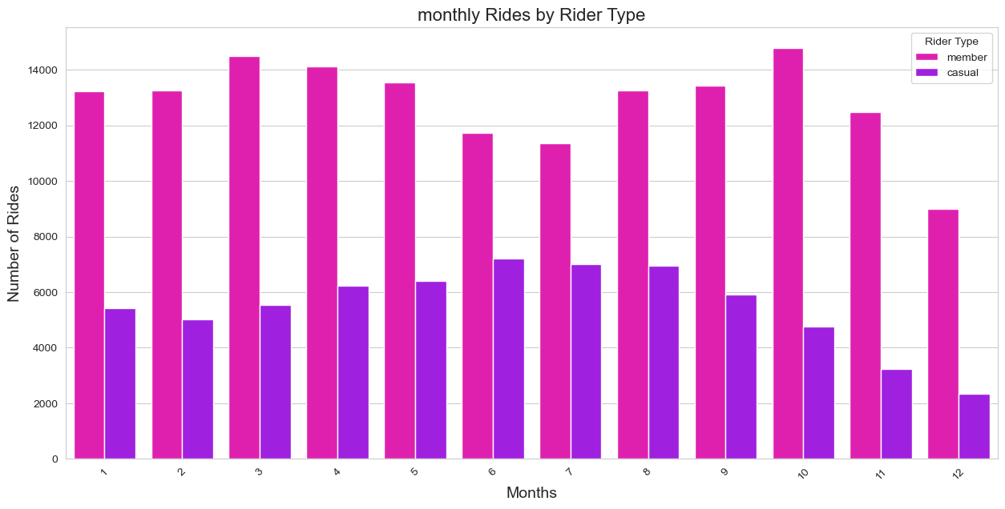
Does season have a role to play?

Slide 9
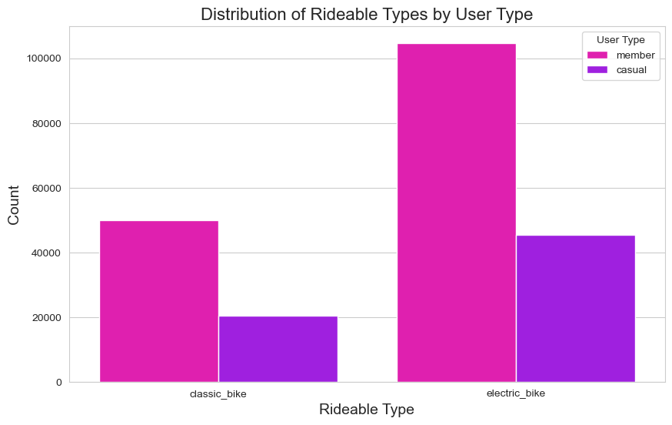
What type of bikes are being used by different users?

Slide 10
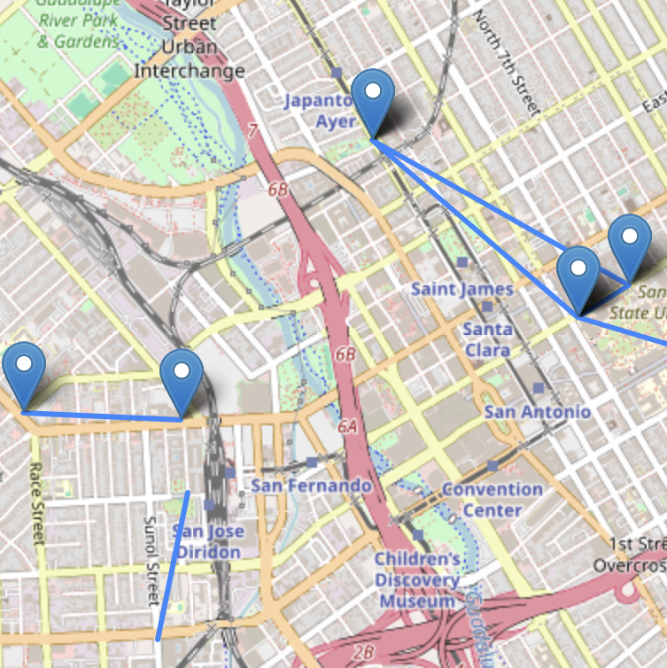
What are the most popular stations that the users are travelling to and from?

Slide 11

Conclusion of Baseline Analysis
Our baseline analysis shows that we can segregate the users at most by 2.
It is 2 dimensional in its original form.
Doesn't really provide the flexibility to do user profiling.

Slide 12

The Big Problem?
The company faces 3 main problems:
Optimizing station placements
Improving ride availability
Get users to use our services more and drive profitability for the company.

Slide 13
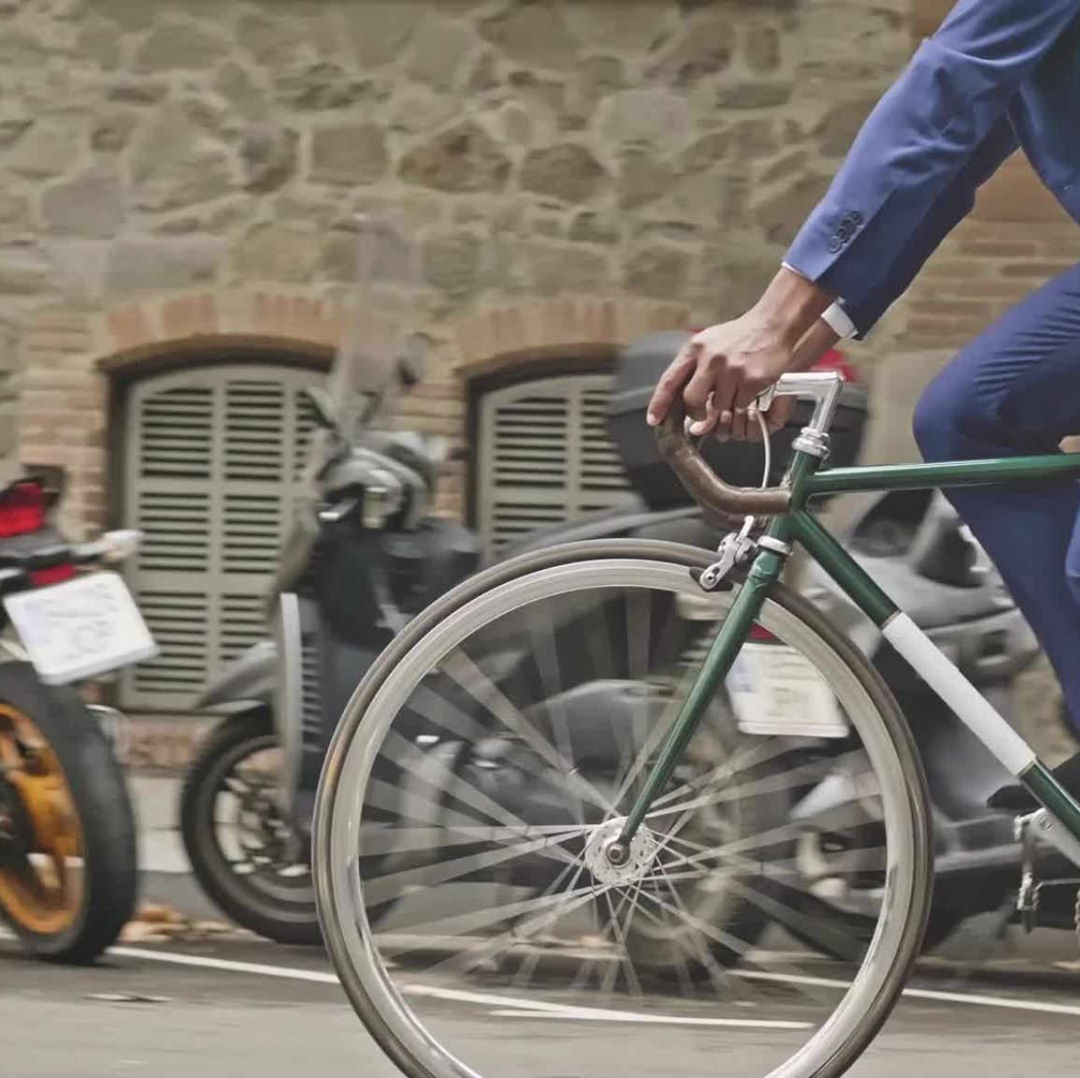
What is our objective?
Given all these information:
Implement a responsive bike reallocation system to ensure availability during peak commute hours.
Launch time-specific promotions aimed at increasing ridership during identified peak times and popular routes.

Slide 14

Who can be profited by our solution?
City Planners and Transportation Authorities
Operations Teams
Marketing Team
Automated systems

Slide 15
Iterative Solutioning
Our baseline analysis showed separating users solely based on the user type is not enough.
We need an algorithm which can capture the geospatial information.
We need to do user profiling based on geospatial information.

Slide 16
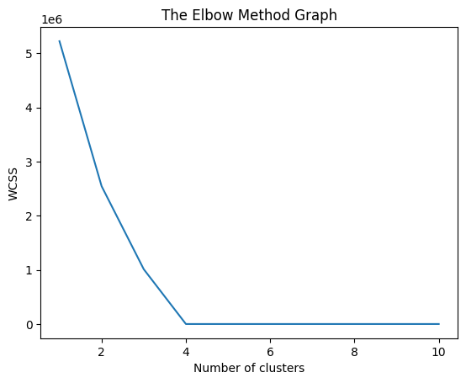
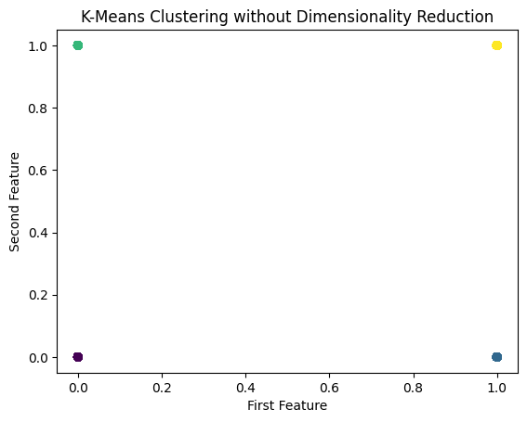
K Means Clustering
K means group observations into K clusters
The best K as 4 using the elbow method
Key insights: Can not correctly justify the clusters using rideable_type and membership of customers

Slide 17
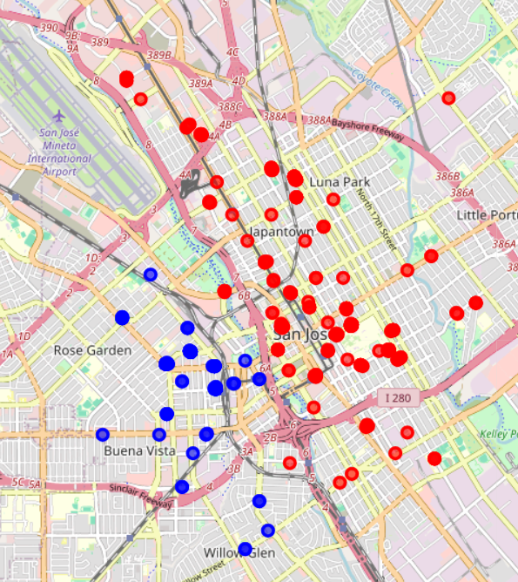
Hierarchical Agglomerative Clustering
It is a tree based clustering algorithm
Datapoints merges with the nearest neighbours and forms clusters
Key insights: Can not correctly justify the clusters i.e. most dominant bikes used areas

Slide 18
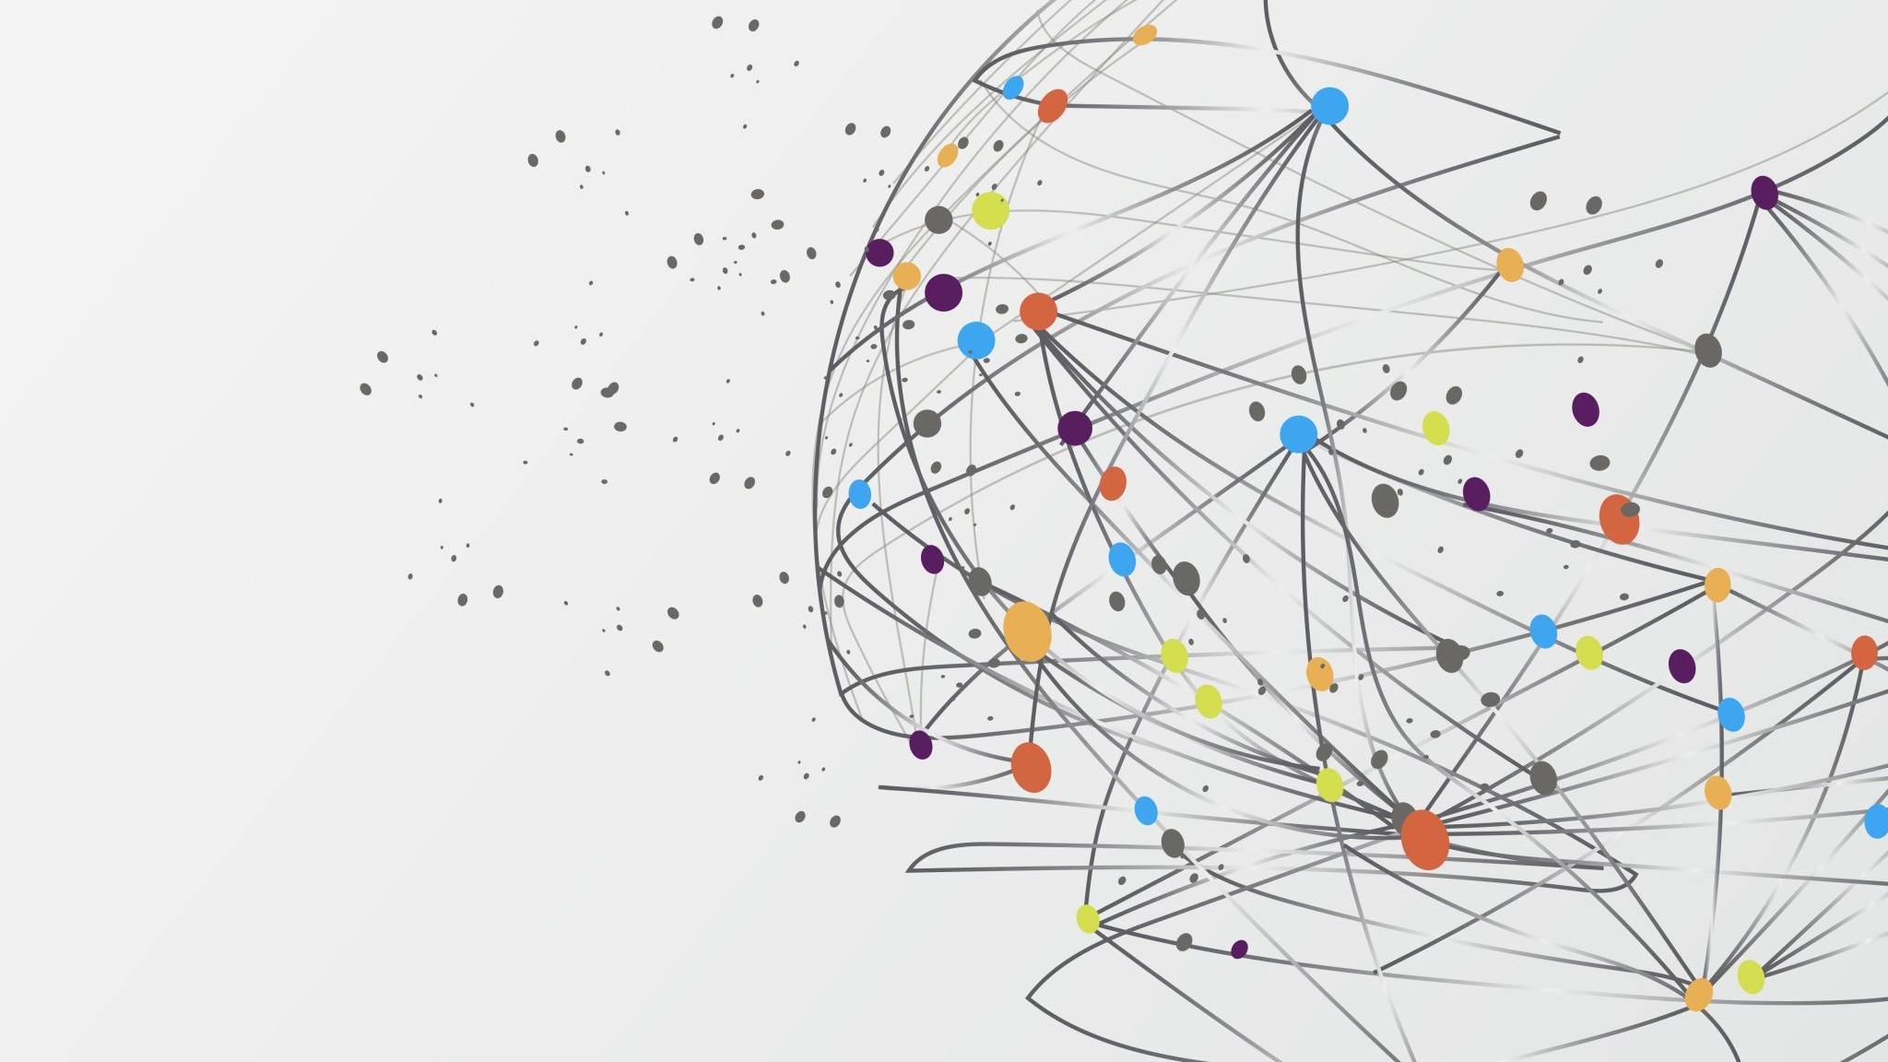
DBSCAN!!!

Slide 19
Our algorithm
It's a density-based clustering algorithm.
The density is determined by how many neighbors a point has within a short distance (eps), and a minimum number of neighbors required to form a group (minPts).
It's great for when you don't know how many groups you're looking for, and you want the algorithm to figure it out based on how data is spread out.

Slide 20

DBSCAN Experimentation
What is a good value of MinPts?
We observed a general pattern:
The larger the data set, the larger the value of MinPts should be
If the data set is noisier, choosing a larger value of MinPts helps
With a lot of trial and error we arrived at the conclusion of the optimal MinPts to be 500.

Slide 21
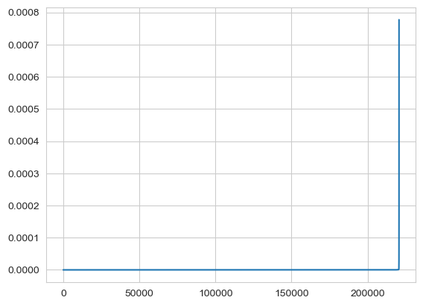
DBSCAN Experimentation
Optimal value of epsilon?
1st approach was to use the MinPts from the previous step.
Use it as the n_neighbours in KNN.
Calculate the average distance between each point and it's K-Nearest Neighbours.
Plot the avg. Distances on a K-distance graph.
The Result?
Lack of clear elbow!!

Slide 22
DBSCAN Experimentation
Alternate approach:
1 km in degrees is approximately 0.008998919 degrees.
Convert latitude and longitude as radians.
Half a Km in degree would be 0.0044994595 degrees.
Choose epsilon(eps) as 0.0044994595 for the DBSCAN with MinPts as 500.

Slide 23
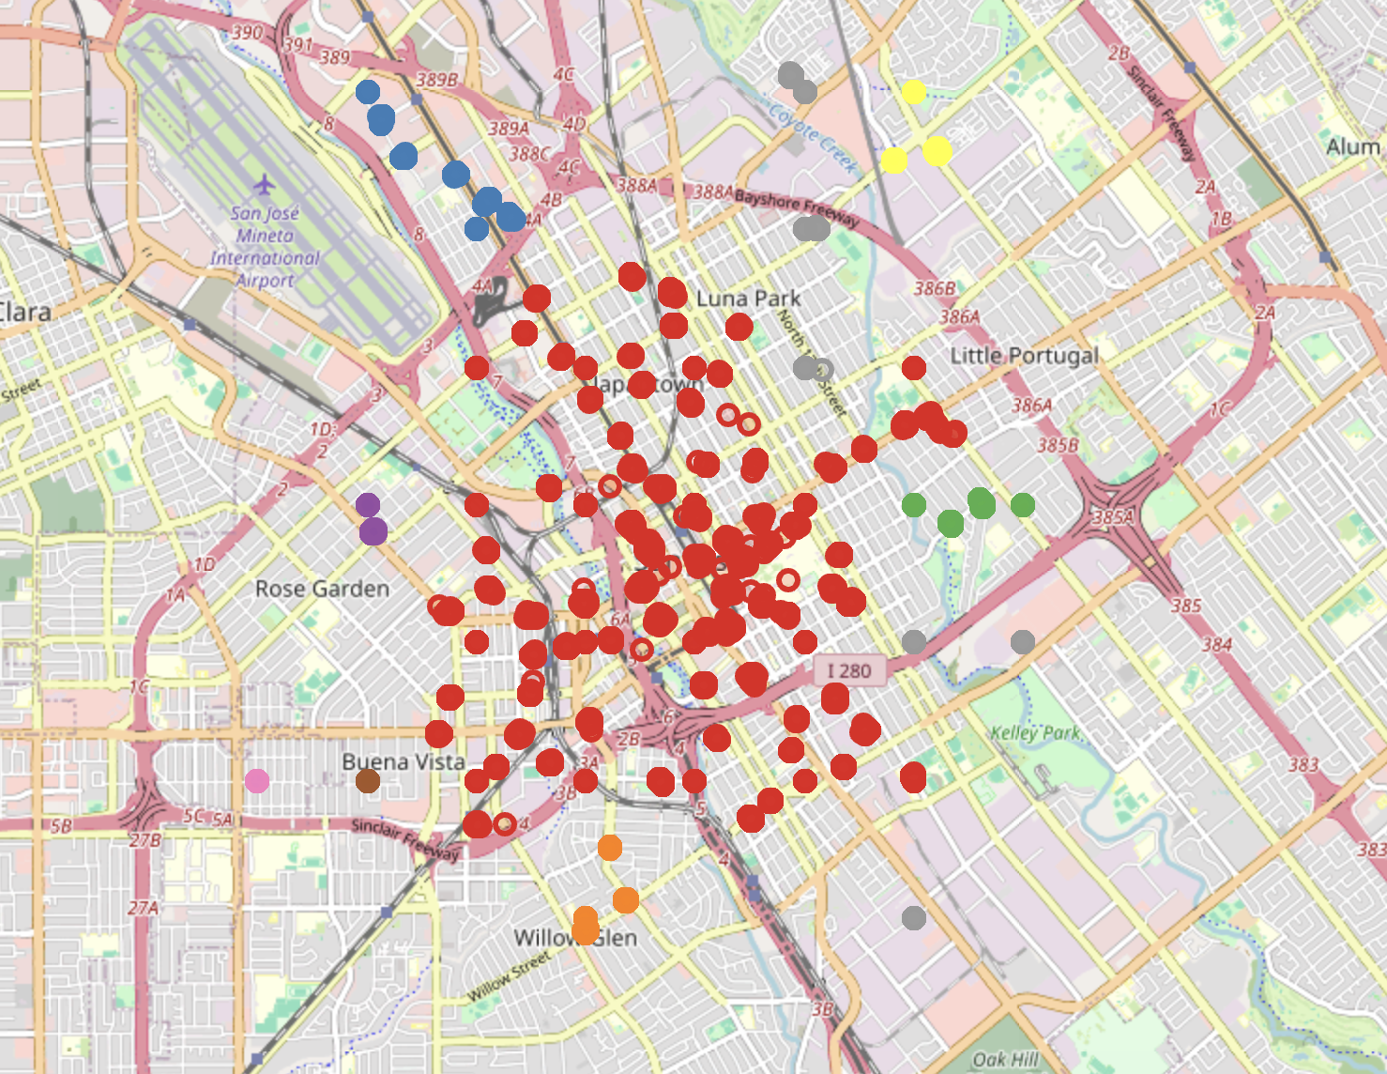
And the result!!!
Density based clustering of bike stations in San Jose

Slide 24
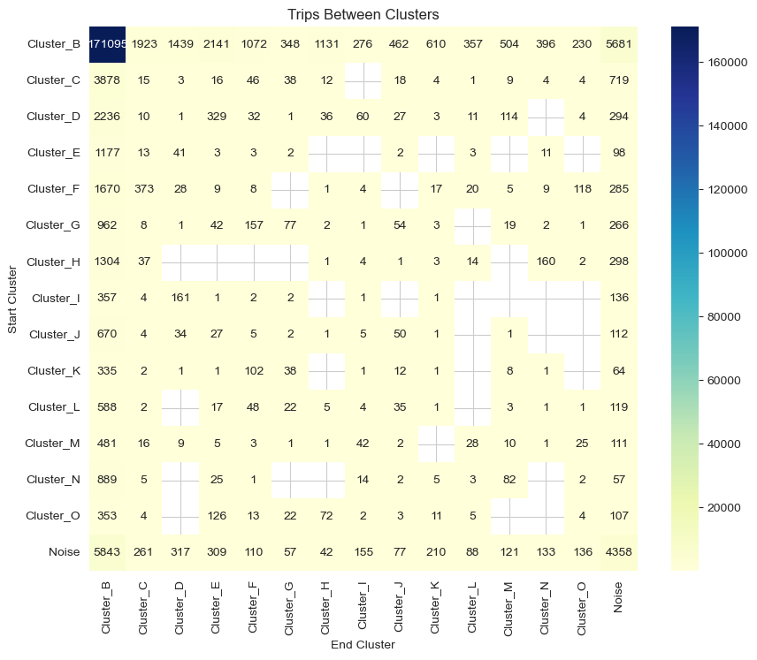
It's not just a cluster!!!
Rides taken between clusters now depict the routes.
Higher the number more frequent the route taken and vice-versa.
Can choose optimal bike stations between two clusters.
Less trips in the route Cluster_C -> Cluster_I
Installing new stations!
Connecting clusters/routes!!
Redistribution of bikes.
Notes:
These are not just zones, but also routes or connections between zones
Idea to introduce stations between the clusters to improve the rides taken along the route.
Connect clusters/routes where there are no trips taken at all.
Redistribute bikes from a poorly utilized route station to the station along the route which has more demand.

Slide 25
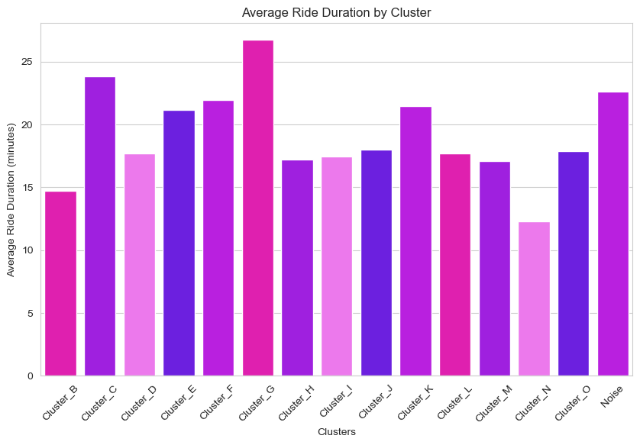
that's not it...
Users of Cluster_G have the longest ride duration.
Knowing the prime customers
User satisfactory programs like promotions, new plans
Notes:
Target users in this cluster with marketing campaigns such as discounts on long rides, loyalty programs, or challenges that encourage exploring new routes.

Slide 26
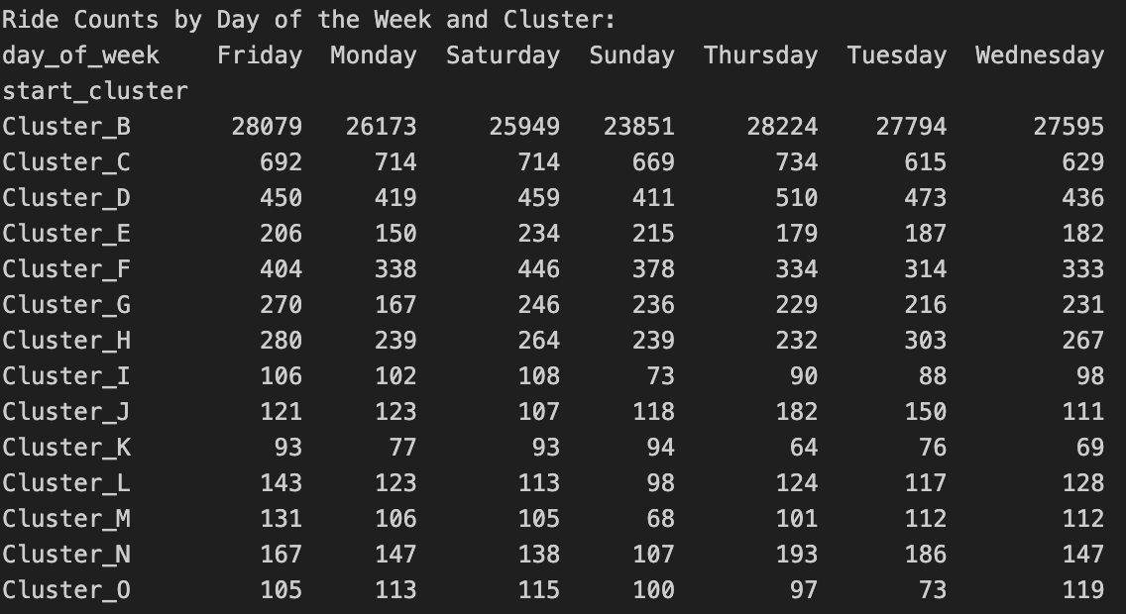
And more...The weekend riders
Promote 'Lazy Sunday' offers for leisure riders.

Slide 27
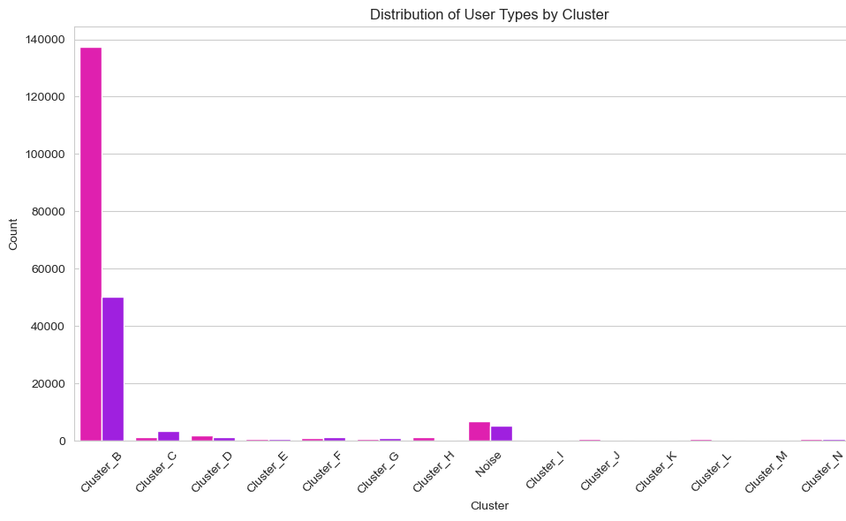
User type distribution by clusters
Apart from the most predominant cluster B where the members, rest of the clusters have almost equal distribution of users.
Run marketing campaigning focusing on these users to buy annual subscription.

Slide 28
Conclusion and Future Work
Next Steps in Urban Mobility:
Apply model to other regions within Lyft's operation.
Adjust clustering for real-time data streams.
Explore predictive modeling for future demand forecasting.

Slide 29
Thank You

